Slide 1
Lessons from the transformation of the doctoral education in Hungary from an Academy-managed system to a university-based system
Ádám KISS
Eötvös University/Budapest
Department of Atomic Physics

Slide 2
Personal approach to the topic:
Full Professor of Physics (1989), Professor Emeritus (since 2012)
1989/1990 vice-dean responsible for science affairs,
1990/1997 dean of Faculty of Science, Eötvös University/Budapest,
1998/2002 secretary of state responsible for Higher Education and Science,
from 1997 to 2007 (two interrupted period) head of Dept. of Atomic Physics,
from 1997 to 2012 head of the Center for Environmental Science,
2006/2012 founder head of PhD School for Environmental Science,
2010/2018 member of the Board for Science of the Accreditation Committee.
Doctor titles: 1970: doct. univ, 1976: CSc, 1988: DSc, 2018: doct. h.c. of TE

Slide 3
Outline of the talk:
I. Doctoral education before the Law on Higher Education in 1993
II. The changes introduced by the Law on HE and the Law on the Hungarian Academy of Sciences (HAS) in 1994
III. The Hungarian Accreditation Committee: mission and practice
IV. A brief overview of the university-based doctoral school system
V. A retrospective critical analysis of the transformation of the doctoral education

Slide 4
I. Hungarian system of doctoral education before the Law on HE (1993) a) A brief history of doctoral education in Hungary
In most countries: the highest degree in science. It goes back to the medieval centuries.
In Hungary there is another degree: the habilitation (right to teach).
In some cases completing a university study gives the right to use “doctor” title: medicine, dental medicine, vets, pharma, juris, rerum politicarum.
Between 1957 and 1993 science degree, this was not accepted by the Academy.
Since 1984: degree given by universities.
Today: the only science degree is PhD (Phylosophiae Doctor) and DLA (Doctor of Liberal Arts).

Slide 5
b) The doctoral education managed by the Academy of Sciences
The Hungarian Academy of Science (HAS - 1825) a highly respected body of the best scientists of the country.
In 1949 it was reorganized by the communists. Many academicians have lost their membership and the empty places were filled by politically loyal persons.
At that time and later the network of research institutions in the country was connected to HAS. HAS itself was fully controlled by the Government and the Party.
The scientific life was divided between the universities and institutions of HAS. The task of the universities was to teach and educate; the research efforts were at research institutions of HAS.
All decisions were made centrally, both for the science body and for the research institutions.
The right to give the scientific degrees belonged to this central authority. This was a soviet type Academy.

Slide 6
Doctor titles given by the Academy
Candidate of Science:(CSc) : soviet type degree. System: aspiranture for 2-3 years. The degree is between the doctor univ and Doctor of Science. The HAS had the right to award it. – Now by law it corresponds to PhD.
Doctor of Science: the right to give it out was at HAS, minimum 5 years after the CSc degree.
Since 1949, the members of the Academy must have the DSc titles. - After 1994 it is not a degree, it is a title, which is given by HAS.
More: doctor honoris causa (h.c.): nothing is required.

Slide 7
c) A critical analysis of the Academy-managed system
The system was of feudal type. It was against the fast get along of talented persons.
The centralized bureaucracy was clumsy and arrogant. The number of persons with the degrees was limited.
Positive side was that (in science and engineering) the party-carrier alone was not enough to come forwards.
The political change came in 1990. The laws on the HAS and on HE touched basically the system.
HAS became a public body of scientists, (academicians ~360 and about 5000 persons with scientific degrees),
the universities got back the right to award scientific degrees,
after long discussions the network of research institutions was left with the Academy.

Slide 8
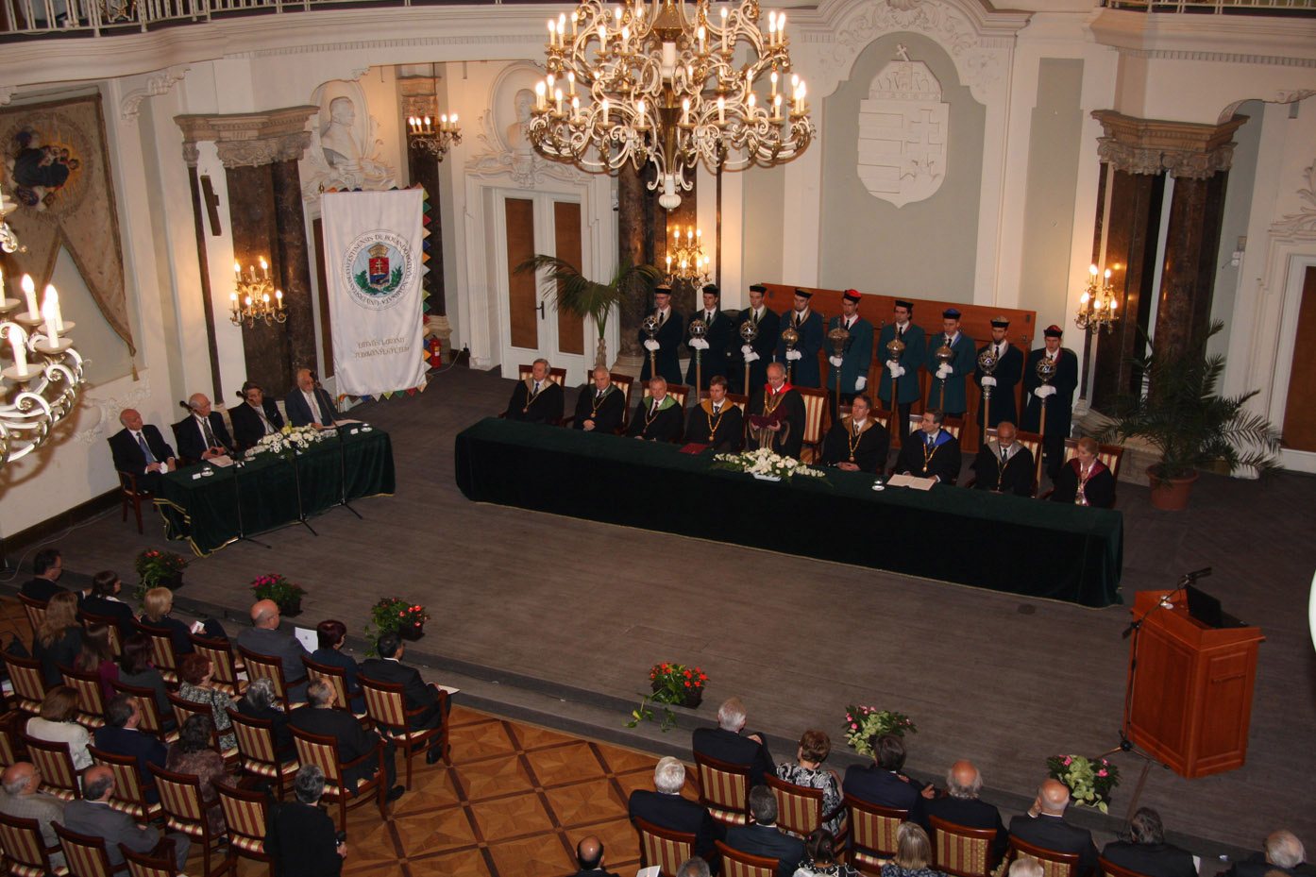
In general: awarding the doctor degree is always a great ceremony

Slide 9
II. The changes introduced by the Law on HE (1993) and on the HAS (1994)
The right of the universities to award PhD (DLA) degrees
The only scientific degree is given by the universities. (It took away the right from the Academy.)
Transisonal reg.: CSc equal to PhD, dr. univ. may be equal with PhD, equivalency procedure for foreign degrees.
b) Establishing doctoral schools at universities
Doctoral (PhD) school: unit for regular education of the most talented students at the universities to become scientist.

Slide 10
Questions at establishing PhD schools: each of them had to be answered
research school (workshop for something) or disciplinary schools for a broader field of science;
how much and what kind of intellectual strength should stand behind a doctoral school;
what should be the connection between the university coworkers and researchers from institutions of Academy;
credit system: how to gather credits from the regular courses and research work;
how to organize the regular courses in doctoral schools;
requirement of summarizing the reasearch in a PhD thesiswork;
what to require at the doctoral exams and how to organize the complex doctoral exams;
how to accept a PhD thesis; what should be the composition of a) exam committee; b) a review committee of a PhD thesis; c) who may be the opponents; d)where are the required levels or what are the notes?

Slide 11
c) The title of Doctor of HAS, the role of HAS
Long debate about the second science level; result: it is not a degree, but it is a title (Doctor of HAS, DSc) with perpetuity.
The title is given by the HAS and the money is in the budget of HAS.
The main reqirements are determinded by the bodies of HAS.
The main universities require the DSc for the full professorship. (It is not required by the law.)
Many have the opinion: the situation is a heritage of the communist area - everything should go to the universities.

Slide 12
d) The relation of the universities and the network of research institutions
The university research, national laboratory research and international efforts in science are all justified
all those research with the characteristics “several people in several years produce an important paper” is a typical task for university research (a doctor thesis in some years); the research itself is irresponsible, good for PhD school;
there are research activities, which require the coherent and collective motion of many people for a long time, it is a responsible research. These investigations may not be conducted at universities, but in national laboratories. Such researches are e.g. reactor research or some agrarian investigation, or to use bigger accelerators;
There are researches which require international unified efforts, like CERN or LIGO (Laser Interferometer Gravitational wave Observatory) etc.

Slide 13
III. The tasks and practice of the Hungarian Accreditation Committee
It plays a central role: the Accreditation Committee was created with the main tasks:
to establish and control the university degrees as for training aims and disciplinary content,
to control the quality of the education,
to approve the establishment of a doctoral school, to control the quality of the staff members of the PhD schools, continuous control on quality,
to accredit the institutions of higher education,
opinion about the appointment to full professor.

Slide 14
a) The rights of the Accreditation Committee
It has a right to supervise regularly the quality of (almost) all aspects of university life. Among many other rights, to establish or stop PhD schools, education in the schools or disciplines.
b) The build-up of the Accreditation Committee
The president is appointed by the prime minister. It has a plenum, which has the right to decide all questions. There are several expert’s committees, which discuss the problems close to their disciplines.
c)The practice of the AC
The budget of AC is not in the budget of Ministry for education, which ensures independency. It is true that there are many unsatisfying moments in their activities.

Slide 15
IV. The overview of the university-based doctoral school system a) The results and achievements of the system
The system has proved to be appropriate for education of scientists. Many scientists got their degree via this procedure.
The regular PhD training can be state financed or private financed. The PhD scholarship was originally for three years. This time length is in most cases not long enough to get the degree, the average is about 4,5 years.
Less than half of the students get the degree. Where are the others? What can we do for them?
Two years ago (2017) the scholarship became 2+2 years with a general control after 2 years.
How to integrate graduate students into the university education? It is not clear.
Sometime there is the question: can the PhD training be shorter? No, it is not recommended.
How to establish a real social life of the graduate students of the same school?
How to guarantee that the courses are real courses and not a discussion of the professor with one or two students?

Slide 16
b) Operational differences of the function of the graduate schools at different universities
The universities in Hungary are very different from each other. Many different doctoral schools were established.
The personal composition is required by AC: at least 7 committed scientists may establish a new doctoral school, 4 of them should be full professors of the university. There may not be more outside members, as internals.
c) Difficulties and weaknesses of the university based system
As the persons becoming full professors are not young, there are a relatively fast (in several years) change in the list of the main persons. A quick decision of government to send professors into pension can be a catastrophe for the doctoral schools. Similarly, the brain-drain can create difficulties in some PhD schools.
How to work together with foreign universities to promote the same student? How to work together with research institution of HAS or with others?

Slide 17
V. Retrospective critical analysis of the transformation of the doctoral education Many mistakes were made!
Summarizing results:
as one degree was left out, the scientists get their scientific degree earlier and even the title doctor of HAS comes at an earlier age; this means that the professors are some years younger than earlier.
The number of PhD students should go up. However, high salaries attract the students away from the universities.
The length of the PhD school training was estimated for too short. There were problems that the students did not have income for one or two years.
The problem is not solved: development of a collegial cooperative scientific atmosphere for the community of the students belonging to the same doctoral school.

Slide 18
Thank you for your attention! Questions?

